Slide 1
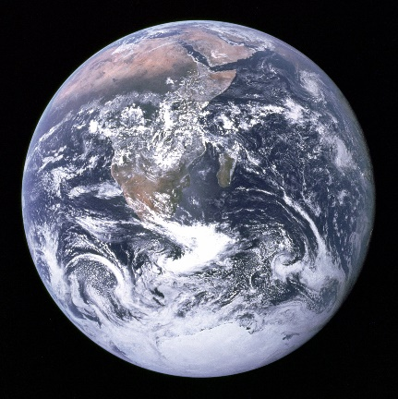
CAMBIOSCOPE Carbon Management & Bio-ressources Strategies for Scoping the Transition towards low fossil Carbon
Lorie Hamelin, PhD
Foulum, March 15th 2018
CBIO Seminar
A 5-y project of the Make Our Planet Great Again initiative / Energy Transition
Notes:
25 min tot
Real Pleasure to be here with you all : researchers, business & sustainability leaders, policy makers and advisors that are all innovators & creative thinkers when it comes to bioeconomy
I want to engage in a conversation ….
“How do we make the (circular) Bioeconomy work?”

Slide 2
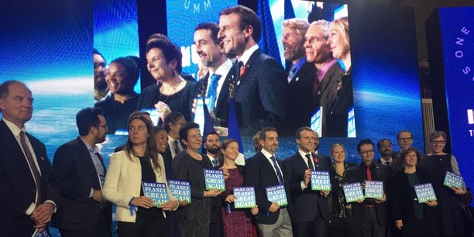
Make Our Planet Great Again (MOPGA)
French President’s initiative
3 key topics
Earth System
Climate Change & Sustainability
Energy Transition
Call also launched in Germany
Round 1:
1822 applications
450 screened out
Round 2: Long form
90 screened out; 57/90 did apply
Round 3: Project proposal. Chair of panel: Prof. Corrine Le Quéré. 127 experts contacted
18 projects selected

Slide 3
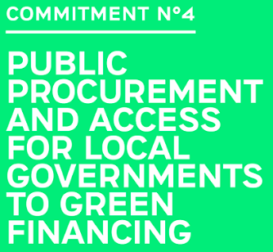
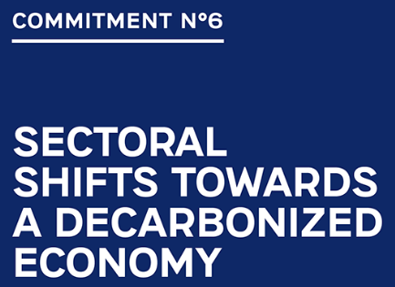
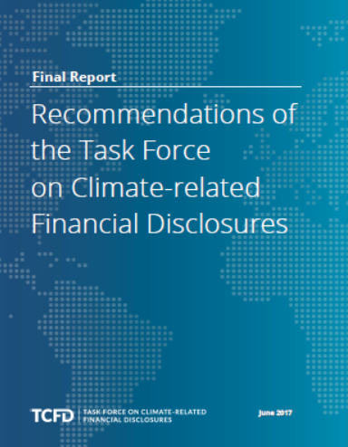
One Planet Summit
https://www.oneplanetsummit.fr/en/the-12-oneplanet-commitments/
Notes:
I had the opportunity to attend the OnePlanet Summit, and this has been an extremely inspiring experience, so I want to quickly share it with you. Ca. 50 head of states, philantropists, huge venture funds, insurance companies and alike. Focus not on target but on actions.
Highlights:
Commit.6:
The alliance is committed to speeding up the elimination of conventional coal-fired power stations in a sustainable and economically inclusive manner, and to imposing a moratorium on new conventional coal-fired power stations without carbon capture and storage systems
World Bank to end financial support to oil & gas extraction.
Commit.9:
Strong agenda for asset managers and owner to favour investments in companies better prepared to deal with the risks of climate changes.
Commit.11:
6 of the largest sovereign wealth funds create an ESG framework (environmental, social and governance) to guide their investment decision ( Kuwait, Norway, Qatar, New Zealand, Saudi Arabia and the United Arab Emirates )
==========
Commit.7: 8 countries including Portugal, the Netherlands, Costa Rica and France, supported by the stakeholders of the Paris Process on Mobility and Climate (PPMC) platform, are creating an alliance to work together on roadmaps towards decarbonizing transport and increasing investment in clean transport + 34 countries pledge to reduce maritime transport emissions
Commit. 1: 8 billion investment plan to make the Caribbean the first Climate Smart Zone
Commit.2: A $650 million financing programme for research to help smallholder farmers adapt to climate change
Commit. 4; The C40, a network of 90 metropolitan areas, the Global Covenant of Mayors, United Cities and Local Governments and Local Governments for Sustainability have joined forces to launch green public procurement contracts (sustainable infrastructures, green mobility, zero-emissions housing, energy efficiency etc.) in an agreed framework.
Commit.5: Led by the Marshall Islands and New Zealand, the "Towards Carbon Neutrality” coalition has today got support from 16 countries that have committed to publish by 2018 and no later than 2020 a “carbon neutrality” path by 2050. In addition, 32 cities and numerous businesses have taken carbon neutrality goals.
Commit.6: The alliance is committed to speeding up the elimination of conventional coal-fired power stations in a sustainable and economically inclusive manner, and to imposing a moratorium on new conventional coal-fired power stations without carbon capture and storage systems. France has committed to ending all electricity production from coal by 2022.
Commit.7: Faced with the urgency of committing to a profound transformation of transport, eight countries including Portugal, the Netherlands, Costa Rica and France, supported by the stakeholders of the Paris Process on Mobility and Climate (PPMC) platform, are creating an alliance to work together on roadmaps towards decarbonizing transport and increasing investment in clean transport
34 countries pledge to reduce maritime transport emissions: emissions relating to maritime transport currently account for 3% of global CO2 emissions but they could rise 250% by 2050 if no targeted action is taken.
Commit.9: Today, 3 countries (France, Sweden and the UK), as well as more than 200 businesses have announced their support to the implementation of the recommendations from Task Force on Climate-related Financial Disclosure (TCFD)
Commit.10: More than 30 public development banks commit to align their financing with the Paris Agreement. Among other, they commit to: support the implementation of national contributions and preparation of long term decarbonised trajectories by 2050
Commit.11: 6 of the largest sovereign wealth funds create an ESG framework (environmental, social and governance) to guide their investment decision
Sovereign funds hold assets which could reach over $15 trillion by 2020. At the initiative of the President of the French Republic, Kuwait, Norway, Qatar, New Zealand, Saudi Arabia and the United Arab Emirates are launching an unprecedented coalition of large sovereign funds in support of climate action. The initiative will be coordinated by France.
Commit. 12: The “Climate Action 100+” coalition was launched during the One Planet Summit. It brings together 225 major institutional investors representing more than $26 trillion in managed assets to coordinate their actions as regards the 100 highest-emitting public companies. + $1bn Energy Breakthrough Coalition: investing in breakthrough technologies
Engagement principaux
La Commission européenne veut un secteur financier au service du climat : les entreprises et les technologies doivent s'investir dans des pratiques durables.
La Banque mondiale ne participera plus au financement des énergies fossiles.
Les banques de développement devront libérer plus de moyens financiers pour les dépenses en lien avec l'Accord de Paris.
Les fonds souverains décident de s'engager et de financer davantage des actions en faveur de l'action climatique. Ils décident de former une coalition entre la Norvège, les Émirats arabes unis, l'Arabie saoudite, le Qatar, le Koweït et la Nouvelle-Zélande.
Les investisseurs institutionnels feront pression sur les 100 entreprises cotées les plus émettrices de gaz à effet de serre.
Axa s'engage à désinvestir encore dans le charbon (2,4 milliards d'euros supplémentaires de ses actifs dans le charbon et 700 millions d'euros de ses actifs dans les sables bitumineux.)
De nombreuses entreprises s'engagent à être transparentes et fournir les informations nécessaires aux investisseurs quant à leurs impacts sur le climat.
Un accord entre le programme des Nations unies pour l'environnement et le Centre international pour la recherche en agroforesterie devra lever plus de moyens pour financer des projets durables dans les pays en développement.
Pour préserver les ressources, un fonds de lutte contre la dégradation des terres et la désertification. Des moyens financiers vont également être débloqués en faveur de la mise en place d'une agriculture responsable.
La Fondation Gates et BNP Paribas et la Commission européenne vont débloquer des moyens financier pour aider les jeunes chercheurs de pays émergents

Slide 4
Green momentum in France right now
100% renewable gas by 2050 (<1% today)
No coal in electricity mix by 2022 (<5% today)
All household biowaste to be separately collected by 2025 (<15% today)
Electric cars: (27% of price, max. 6000€) reduction for purchasing a new electric car (+ 2500€ if giving away an old car)
Notes:
biomethane (upgraded biogas) in France compared to 2015, where it represented 0.02% of the overall gas consumption.

Slide 5
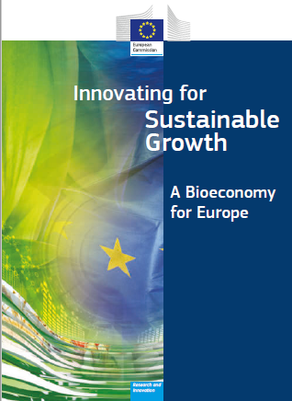
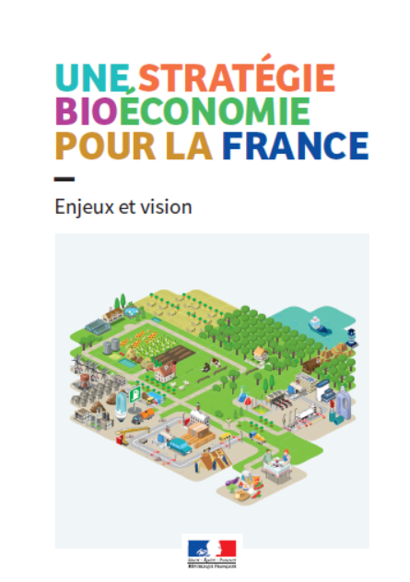
Cambioscope
Context/premise:
Bioeconomy + Circular Economy are EU & French priorities
EU/France is engaged in a transition towards decarbonization
Urgency to stabilize global climate calls for solutions to postpone release of climate forcers, and even induce negative emissions
Main research question:
How should France develop its bioeconomy in the transition towards decarbonization?
How to invest the money, when and where?
Notes:
There are many reasons for this. But before I go further, I just want to do a little experiment. How many thinks that (first bullet) is a good idea?
When it comes to climate, timing is everything.
*****So we ensure that investment choices are consistent with ensuring a SUSTAINABLE and COMPETITIVE bioeconomy tomorrow
****so there is a strong spatial and time dependency that will be adressed
==========================
The European Commission has set a long-term goal to develop a competitive, ressource efficiennt and low fossil C economy by 2050
Smart in how we invest TODAY
The aim is to decouple our economic growth from resource and energy use,reduce CO2 emissions, enhance competitiveness and promote greater energy security´. ent. However, holistic approaches to bioeconomy
research and monitoring are still at an early stage.
The circular economy approach aims to maintain the value of products and materials for as long as possible whilst minimising resource use and gene-ration of waste.
Negative emissions: needed to stabilize global temperature
Biomass is, thus, in growing demand for heat and power services as well as for transportation fuels and as feedstock for chemicals and materials – i.e. in practice all sectors today being dependant on fossil fuels.
Wish but how to organize it Negative emissions are necessary
Key methodologies Csq LCA (macroscrope) + geo-localized assessment + time dependencu

Slide 6
Ambition
Develop a foundation for establishing geo-localized, time-dependant and sustainable strategies
300 conversion pathways to be investigated
Methodological development
Tailored and quantified cost- and environmentally-efficient strategies towards the long-term development of France’s bioeconomy
Focus: residual biomass streams and bio-pump grasses
Notes:
**will focus on residual biomass stream likely to be found in high density in France, namely agricultural residues such as manure and straw, forestry residues
Biopump: perennial C3 and C4 grass species allowing for a net transfer of carbon towards the soil carbon pool
==================
Strategic research

Slide 7
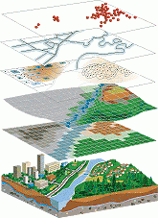
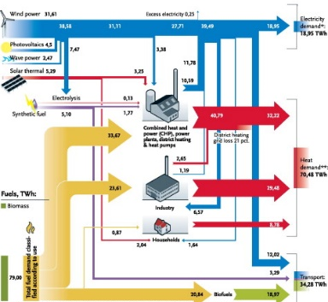
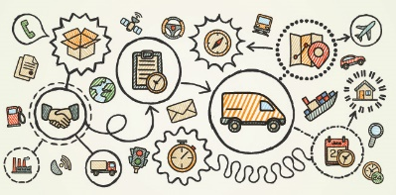
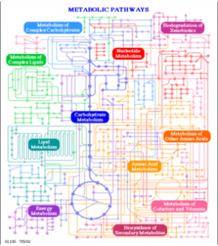
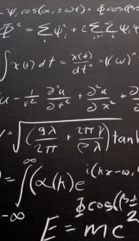
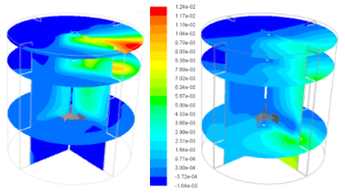
Vision
LCA
.
.
.
.
.
.
Materials production
Product manufacture
Use
Disposal
Geo-Spatial analysis
Energy System Analysis
Uncover limits of bioeconomy and guide research & investment towards the most promising technologies, supply chains & business models
Supply chain economics
Agro-ecology & soil science
Process engineering & meta-heuristics
Notes:
We will work at the interface between disciplines that include consequential LCA, Geopspatial analysis,
looking at systems in integration rather than optimizing each in isolation

Slide 8
Vision: maximize interactions with stakeholders
From May 7th
SDG France (indicator data)
National Institute for Statistics and Economic Studies
Bioeconomy stakeholders (platform IMPROVE, etc.)
Agriculture stakeholders (Agribalyse/MEANS & ClimAgri, AgriTransfer-RT)
Energy stakeholders
On-going initiatives (4 per mille, etc.)
Notes:
Not duplicating what has already been done!!!! First thing I will do when I start is to organize a national workshop to collect an overview of all on-going initiatives.

Slide 9
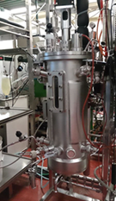
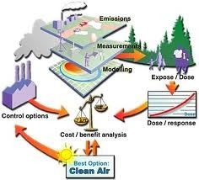
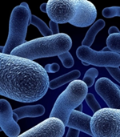
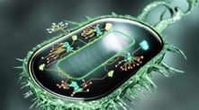
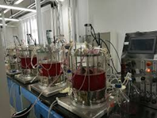
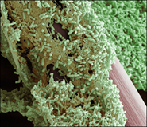
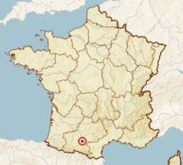
LISBP: a cascade of competences in biology, biotechnology and chemical engineering
PILOTS,
SCALE UP
ENVIRONMENTAL ASSESSMENT,
ECOCONCEPTION
MICRO-ORGANISMS,
PHYSIOLOGY
APPLICATION
Platform molecules,
Bioenergy,
Food supplements,
Pharmaceutical compounds,
Waste & water
treatment
GENOMES
SYNTHETIC BIOLOGY
SEPARATION
PROCESSES
INTERFACE
MASS TRANSFER
BIOCATALYSIS,
ENZYMES
BIOREACTOR
BIOFILMS,
GRANULES
Paris
Toulouse
Notes:
(Engineering of biological systems and processes lab)
The lab where I will be based: called LISBP in Toulouse
This really is a process engineering lab. They work a lot with ASPEN and simulation and scaling up of processes.
* Extraction & dehydration process to optimize throughput of grass biorefineries,
* bio-polymer production from industrial waste water,
* develop. of non-fossil routes for the industrial production of methionine
* Bio-based aviation fuels
* Lignin bioref
There, I will use the same approach, get an overview of all on-going projects
LISBP: 340 people (85 researchers & teachers - 75 engineers, technicians & administrative - 180 not permanent people)
Budget ~ 20 M€/year (10 M€ contracts)
*2,4 DHB : 2,4 dihydroxybuyrate
In total, the project involve research contribution of 20 professor, researchers and engineers.
Platform molecules = building blocks, e.g. VFA, succinic acid, lactic acid
« Paper: platform chemicals such as C6 sugars, 5-hydroxymethylfurfural, furfural, gamma-valerolactone, xylitol, 2,5-furandicarboxylic acid, levulinic acid, ethanol and others from sustainable »
JMF example:
Separation process to make protein recovery from grass more efficient (re-check, maria…)
Aspen, …

Slide 10
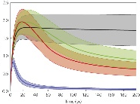
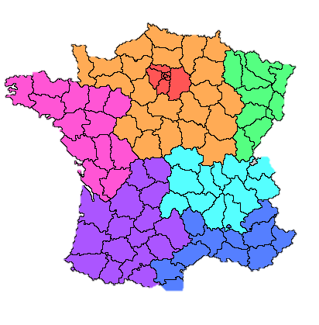
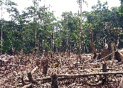
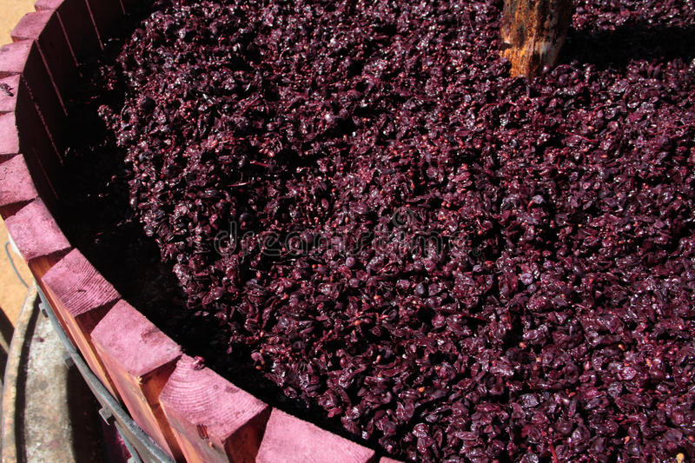
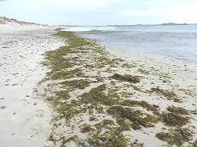
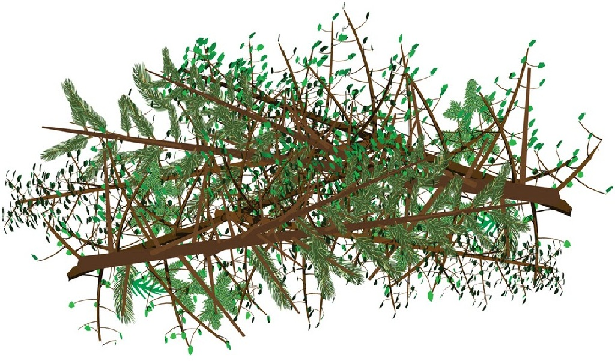
Project workflow
Postdoc 1
1.5 years
PhD
3 years
Postdoc 2
1.5 years
PI
5 years
Year 2-3
CO₂
Year 2-3-4
RO5
C
Threshold & Carbon redistribution
Biomass conversion pathways (LCI)
Carbon circularity, time & narratives // Methodological development
Year 1-2
RO2
RO3
C, N, P flows
Counterfactual
Most promising pathways
Geo- & time-explicit bioeconomy LCI Database
Residual biomass baseline
Year 4-5
Bio-pumps
RO4
RO1
RO6
Final LCA on selected bioeconomy models
Logistics, markets, economy of scale
Notes:
Project workflow….over the 5 years. There are 6 RO, and each is attached to one of the key project team member.
RO1: explain. (…). The vision is to have a baseline against which the environmental performance of any strategies can be quantified against.
RO4: Meta-analysis to uncover the key parameter upon which the performance of bio-pumps varies (C seq, biomass production, biodiv, land & water req). We will look at a broad range of species (tall Festuca species, Miscanthus, alfalfa, deep-root species). This will allow to geo-quantify the potential for these in France. The vision is to reflect the range of possibilities for these: using current future marginal land only or a maximum integration via a reorganization of the agriculture)
RO2: systematic scoring system based on a number of criteria and sub-criteria. Flexibility, innovation, circularity, market potential may be some of these. Whole range of TRL. I want to involve stakeholders in this process. Pathways involving recovered CO2 as a feedstock will also be considered (C-conserving processes) as well as interaction with the energy system through the use of excess power and production of heat.
RO3: Methodological advances to reflect how long carbon stays in the technosphere and thus which pathway allows to postpone the release of climate forcers.. This will involve the need to develop narratives considering the evolution of underlying framework conditions. We will build on published EU and France strategies and other initiatives like IIASA’s. Near-term climate forcers (aerosols, ozone precursors, volatile organic compound, carbon monoxide will be included)
RO5: Cross-reference results of RO1 for crop residues and animal manure with top soil data. The vision is to determine how much residues can be used without return and where. Then, for pathways allowing return to soil, how to organize the re-distribution so we have a max of biomass available?
RO6: Uncover the key barriers for penetration of most performant LCAs pathways. This includes an analysis of supply-chain economics logistics , competition for biomass resource, new market impacts, and geo-localization of the feedstock.
=> Tailored cost- and env-efficient bioeconomy models.
RO4/ Grass-based biorefinery
First mention steering committee
Philosophy: nothing is taken out of the blue, all RO are pushing fwd earlier work // not duplicating what is already there
RO1, then 3, then 2, 4, 6, 7/5
Biorefineries entail a mix of cutting-edge technologies with high potential for innovation and high added value.
Novelty lies in these advances, but in particular in integrating it together
fusing satellite-derived land cover data with detailed census and inventory data.
First geo- & time-explicit LCI database entirely dedicated to bioeconomy
RO3 – my role limited to prepare data for postdoc
RO4 - Matrix to select cases **re-check**

Slide 11
International collaborations
Network
University: Aarhus/CBIO, Copenhagen, Utrecht, Hohenheim, Chalmers, Cranfield, KIT, Minnesota or MIT, ETH Zurich
Institutional: JRC-Sevilla, VTT, IIASA, IINAS, LUKE, SEI, Ellen McArthur Foundation
Industry: Access to LISBP industrial partners (Adisseo, Airbus, etc.)
Other: French lead of commitment 11 (sovereign fund)
Contacted
Not contacted
Notes:
Steering committee and academic exchanges – there is a planned budget for that
Minesota: GLI (global land initiative) lab
Harmonising and upgrading greenhouse gas removal consequential life cycle assessment, led by Pietro Goglio, Cranfield University.
LUKE/ The aim of the institute is to “build a society based on bioeconomy”.
Red; IIASA, VTT

Slide 12
Vision
Among the few bioeconomy team in Europe bridging the gap between upstream biomass assessment and state-of-the-art process modelling, in an integrated way leaving no co-products out;
Front-runner in combining time- and spatially-explicit dependencies for LCA and supplying datasets/methods to do so;
Adressing carbon circularity into LCA;
Adressing the environmental performance of cutting-edge bio-economy products;
First meta-study on bio-pumps (in a bioeconomy perspective);
Ensuring the long-term: Apply to ERC Consolidator (year 3).
Bio-economy
Circular economy
Notes:
LCA // upstream // process // downstream/circularity
4 per 1000: increase qty of C in soils by 0.4% so we halt annual CO2 increase in atm - La France s’engage à avoir au moins 50 % de ses exploitations engagées dans l’agro-écologie d’ici à 2020. Les pratiques agro-écologiques permettent d’améliorer la performance économique, sociale et environnementale des agriculteurs, en particulier grâce à une gestion plus durable des sols.
Chalmers in Sweden
LUKE/ The aim of the institute is to “build a society based on bioeconomy”.
USA; MIT for time dependency or Minessota for GIS/Earth stat
Ellen mc arthur foundation for circular economy
Ghent for bio pump

Slide 13
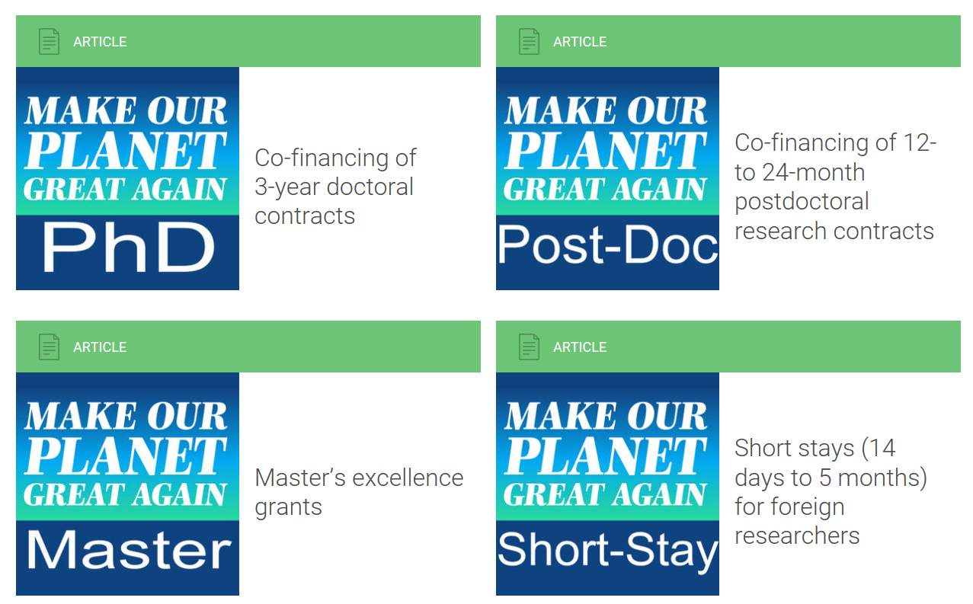
New call – deadline April 6th
https://www.campusfrance.org/en/make-our-planet-great-again-funding-programs
Notes:
Research themes: earth systems, climate change and sustainability, and the energy transition.
must take place between August 1 and December 31, 2018.
Short stays: Successful candidates will receive mobility support in the amount of €65 per day for doctoral candidates and €120 per day for research scientists already holding a doctorate. The maximum mobility period is five months. Roundtrip airfare and medical insurance are also provided. To apply; only CV and list of publications.
Master are partly financed: Successful students will receive an excellence grant in the amount of €1,060 per month over 12 months (for students enrolling in the second year) and over 24 months (for those enrolling in the first year). Round-trip airfare will also be provided, as well as medical insurance and an annual lump-sum payment of €700 for educational expenses.

Slide 14
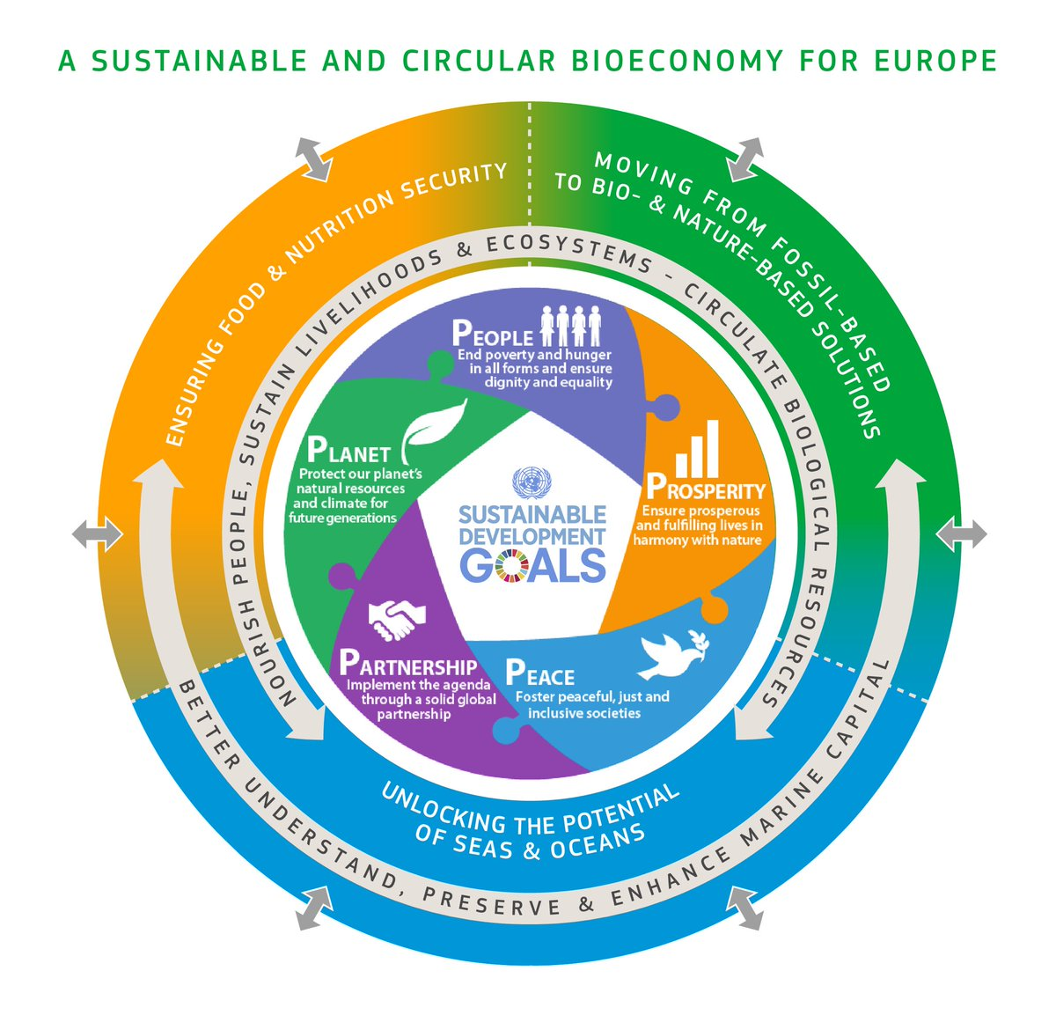
Thanks for your attention! loriehamelin@gmail.com
Source: European Commission
I will recruit 1 PhD (2019) and 2 postdocs (2018, 2021). Contact me if you are interested, or spread the word!

Slide 15
Background material

Slide 16
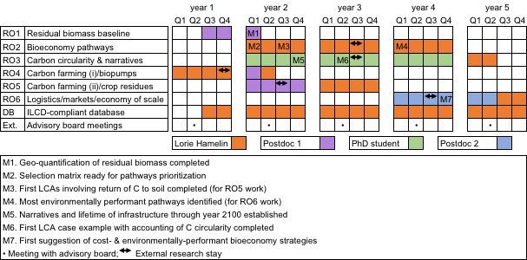
Workflow over project duration

Slide 17
Outreach
Envisioned papers
10 original papers
Envisioned conferences
LCA events
Life Cycle Management and/or SETAC Europe (yearly)
LCA Food 2020
Bio-economy events
BioEconomy Conference Baden Wuttenberg 2019
Circular Economy events
Major Sustainability events
CIGR 2020 (Quebec city) as a facilitating thematic platform
Own final conference/workshop where platform is presented
Group website from start
Notes:
Future Earth; IEA Bioenergy, for circular ecn: https://ec.europa.eu/futurium/en/circular-economy/terms/events/Circular%20Economy

Slide 18
Beyond the project
Maintain momentum and developed competences:
Apply to ERC Consolidator (year 3)
Apply to Horizon 2020 in 2019 (year 2) and/or national calls (ANR), as project partner
Position the group as key bioeconomy leader
Organize a final conference or workshop at year 3 where platform will be presented
Start own bioeconomy journal
Notes:
Max 1 per y
Consolidator Grants may be awarded up to € 2 million for a period of 5 years. (pro rata for projects of shorter duration). 7-12 y after PhD
Starting Grants may be awarded up to € 1.5 million for a period of 5 years. 2-7 y after PhD

Slide 19
Outline
Make Our Planet Great Again / French initiatives
Cambioscope project and LISBP lab
Upcoming opportunities

Slide 20
Integration with hosting lab
Forefront research at the interface between circular- & bio-economy
Spatially-explicit LCA data
Upstream modelling
Process modelling / upscaling / simulation
DyPLCA platform
Several bio-conversion + C circularity projects
Conse-quential LCA
Supply-chain economics
Notes:
LISBP employs 320 people (80 researchers) ### Bioeconomy priority of LISBP
When I decided to apply for the research call:
Occitanie; one of the most dynamic region in Europe (innovation and research wise), second largest agricultural region of France, yet, little known for C management research
Identified potential partners in the region
(3) LISBP: Bioeconomy identified as a priority of LISBP
IMPORTANCE of filling the gap between agro-ecology (resource modeller upstream) and process simulation

